Slide 1
Database Principles
Constructed by Hanh Pham based on slides from:
“Database Processing, Fundamentals, Design, and Implementation”, D. Kroenke, D. Auer, Prentice Hall
“Database Principles: Fundamentals of Design, Implementation, and Management”, C. Coronel, S. Morris, P.Rob
Relational Databases
This slide has 2 parts:
part 1 with pages 1-32 and part 2 with pages 33-69
6-<number>

Slide 2
Outlines (of part 1)
The Problem
Relational Model
Entity
Relation
Functional dependency
Determinant
Keys:
  Candidate key
  Composite key
  Primary key
  Surrogate key
  Foreign key
6-<number>

Slide 3
Chapter Objectives
To understand basic relational terminology
To understand the characteristics of relations
To understand alternative terminology used in describing the relational model
To be able to identify functional dependencies, determinants, and dependent attributes
To identify primary, candidate, and composite keys
About relational database operators, the data dictionary, and the system catalog
How data redundancy is handled in the relational database model
Why indexing is important
6-<number>

Slide 4
The PROBLEM
We have received one or more tables of existing data.
The data is to be stored in a new database.
QUESTION: Should the data be stored as received, or should it be transformed for storage?
6-<number>

Slide 5
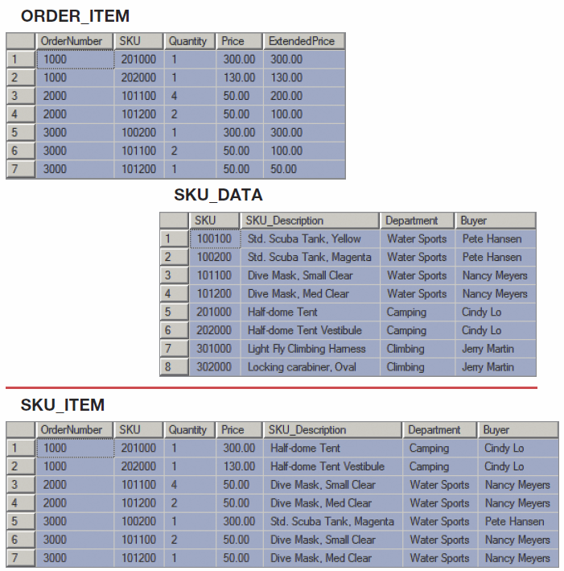
How Many Tables?
Should we store these two tables as they are, or should we combine them into one table in our new database?
6-<number>

Slide 6
The Relational Model
Introduced in 1970
Created by E.F. Codd
  He was an IBM engineer
  The model used mathematics known as “relational algebra”
Now the standard model for commercial DBMS products.
6-<number>

Slide 7
A Logical View of Data
Relational model
  View data logically rather than physically
Logical view is based on relation
  Relation thought of as a table
Table: two-dimensional structure composed of rows and columns
  Structural and data independence
  Resembles a file conceptually
Relational database model is easier to understand than hierarchical and network models
6-<number>

Slide 8
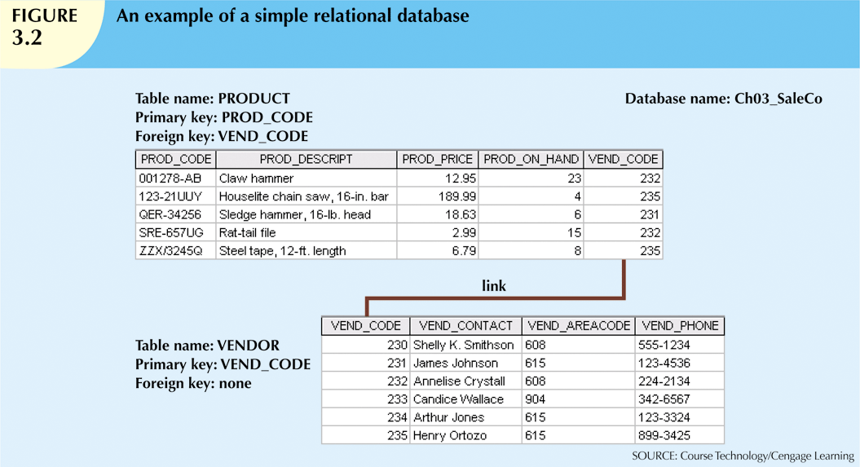

Slide 9
Important Relational Model Terms
Entity
Relation
Functional dependency
Determinant
Keys:
  Candidate key
  Composite key
  Primary key
  Surrogate key
  Foreign key
Referential integrity constraint
Normal form
Multivalued dependency
6-<number>

Slide 10
Entity
An entity is some identifiable thing that users want to track:
  Customers
  Computers
  Sales
6-<number>

Slide 11
Relation
Relational DBMS products store data about entities in relations, which are a special type of table.
A relation is a two-dimensional table that has the following characteristics:
  Rows contain data about an entity.
  Columns contain data about attributes of the entity.
  All entries in a column are of the same kind.
  Each column has a unique name.
  Cells of the table hold a single value.
  The order of the columns is unimportant.
  The order of the rows is unimportant.
  No two rows may be identical.
6-<number>

Slide 12
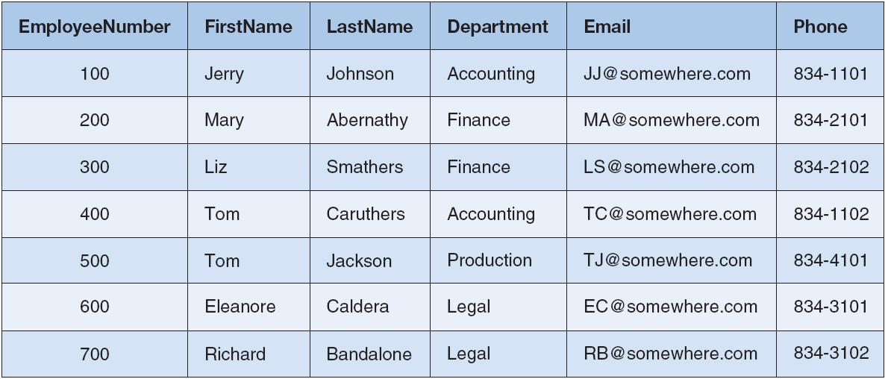
Relation
6-<number>

Slide 13
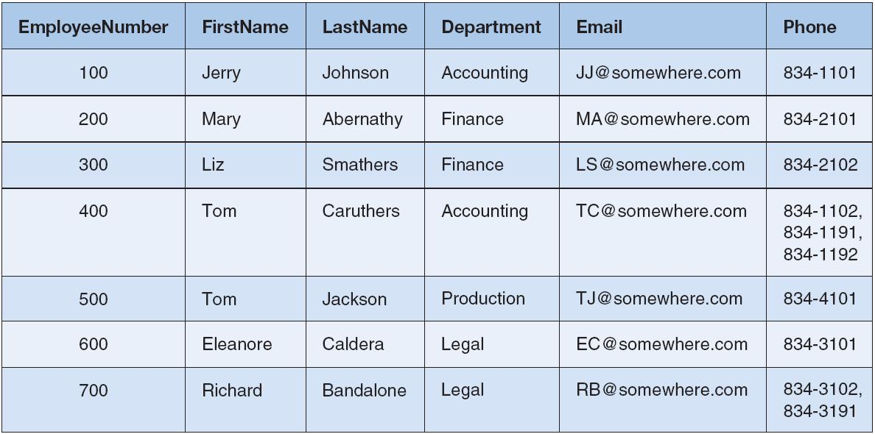
Tables That Are Not Relations:
Multiple Entries per Cell
6-<number>

Slide 14
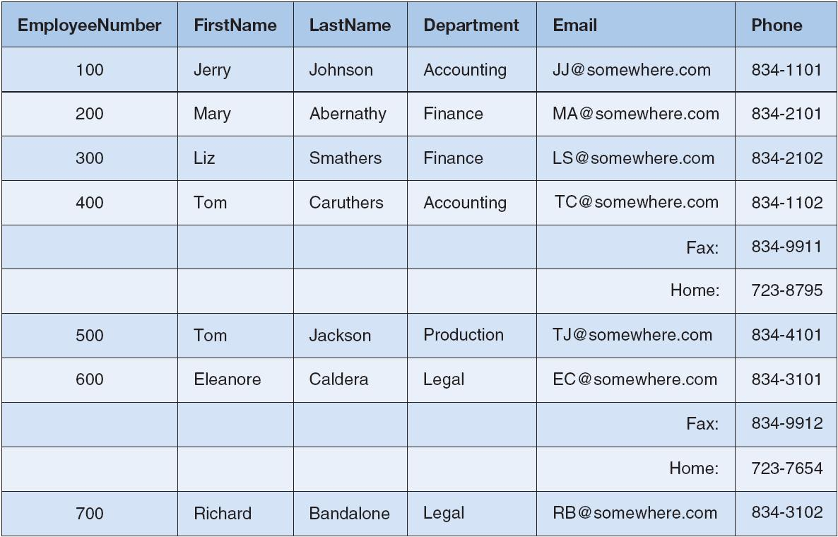
Tables That Are Not Relations:
Table with Required Row Order
6-<number>

Slide 15
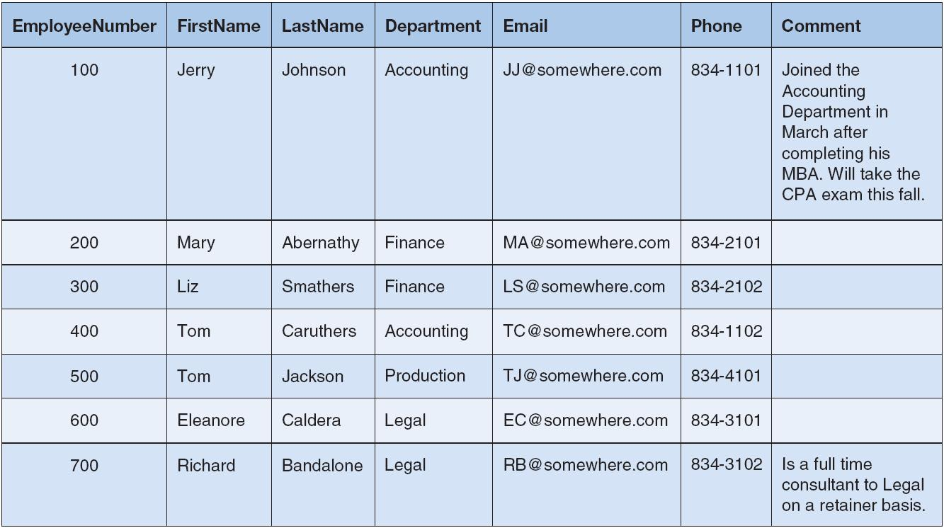
A Relation with Values of Varying Length
6-<number>

Slide 16
Functional Dependency
A functional dependency occurs when the value of one (set of) attribute(s) determines the value of a second (set of) attribute(s):
    StudentID → StudentName
    StudentID → (DormName, DormRoom, Fee)
The attribute on the left side of the functional dependency is called the determinant.
Functional dependencies may be based on equations:
  ExtendedPrice = Quantity X UnitPrice
  (Quantity, UnitPrice) → ExtendedPrice
Function dependencies are not equations!
6-<number>

Slide 17
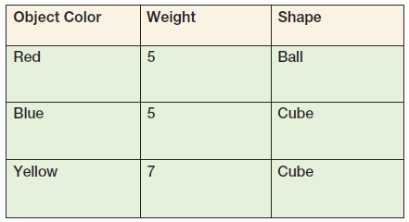
Functional Dependencies Are Not Equations
      ObjectColor → Weight
      ObjectColor → Shape
      ObjectColor → (Weight, Shape)
6-<number>

Slide 18
Composite Determinants
Composite determinant = a determinant of a functional dependency that consists of more than one attribute
(StudentName, ClassName) → (Grade)
6-<number>

Slide 19
Functional Dependency Rules
If A → (B, C), then A → B and A→ C.
If (A,B) → C, then neither A nor B determines C by itself.
6-<number>

Slide 20
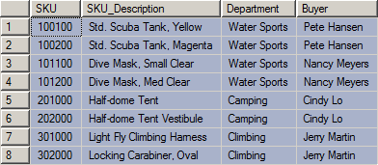
Functional Dependencies in the SKU_DATA Table
1-<number>

Slide 21
Functional Dependencies in the SKU_DATA Table
SKU → (SKU_Description, Department, Buyer)
SKU_Description → (SKU, Department, Buyer)
Buyer → Department
6-<number>

Slide 22
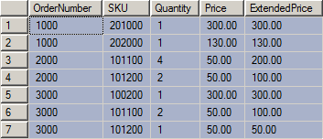
Functional Dependencies in the ORDER_ITEM Table
1-<number>

Slide 23
Functional Dependencies in the ORDER_ITEM Table
(OrderNumber, SKU) →
(Quantity, Price, ExtendedPrice)
(Quantity, Price) → (ExtendedPrice)
6-<number>

Slide 24
What Makes Determinant Values Unique?
A determinant is unique in a relation if and only if, it determines every other column in the relation.
You cannot find the determinants of all functional dependencies simply by looking for unique values in one column:
  Data set limitations
  Must be logically a determinant
6-<number>

Slide 25
Keys
A key is a combination of one or more columns that is used to identify rows in a relation.
  Candidate key
  Composite key
  Primary key
  Surrogate key
  Foreign key
6-<number>

